Slide 1
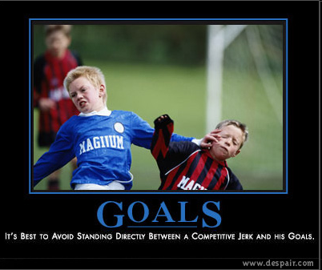

Slide 2
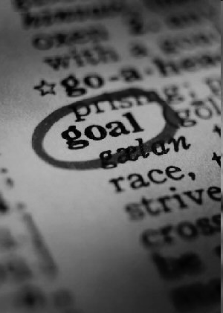
Creating SMART goals
S pecific
M easurable
A ttainable
R ealistic
T imely (and Tangible)

Slide 3
Creating specific goals
A specific goal has a much greater chance of being accomplished than a general goal.
A general goal would be, “Implement common core state standards.“ But a specific goal would say, “Implement one standard every six weeks, and have two formative and one summative assessment with it."

Slide 4
Creating specific goals
To set a specific goal you must answer the six "W" questions:
Who: Who is involved?
What: What do I want to accomplish?
Where: Identify a location. (Science Lab)
When: Establish a time frame. (For second semester)
Which: Identify requirements and constraints.
Why: Specific reasons, purpose or benefits of accomplishing the goal. (To help our students become prepared for the common core state standards, help them become college and career ready, and prepare them for state and national testing.)

Slide 5
Creating measurable goals
Establish concrete criteria for measuring progress toward the attainment of each goal you set.
When you measure your progress, you stay on track, reach your target dates, and experience the exhilaration of achievement that spurs you on to continued effort required to reach your goal.

Slide 6

Creating measurable goals
To determine if your goal is measurable,
ask questions such as:
How much?
How many?
How will I know
when it is accomplished?

Slide 7
Creating attainable goals
When you identify goals that are most important to you, you begin to figure out ways you can make them come true.
You develop the attitudes, abilities, skills, and financial capacity to reach them. You begin seeing previously overlooked opportunities to bring yourself closer to the achievement of your goals.

Slide 8
Creating attainable goals
You can attain most any goal you set when you plan your steps wisely and establish a time frame that allows you to carry out those steps.
Goals that may have seemed far away and out of reach eventually move closer and become attainable, not because your goals shrink, but because you grow and expand to match them.

Slide 9
Creating realistic goals
To be realistic, a goal must represent an objective toward which you are both willing and able to work.
A high goal is frequently easier to reach than a low one because a low goal exerts low motivational force. Some of the hardest jobs you ever accomplished actually seem easy simply because they were a labor of love.

Slide 10
Creating realistic goals
To determine if your goal is realistic,
ask questions such as:
Do I truly believe that it can be accomplished?
Have I accomplished anything similar in the past?
Can I identify the conditions that would have to exist to accomplish this goal?

Slide 11
Creating timely goals
A goal should be grounded within a time frame. With no time frame tied to it, there is no sense of urgency.
When do you want to accomplish your goal? “Someday” won't work. But if you anchor it within a timeframe (“by May 1st”), then you have already set your unconscious mind into motion to begin working on the goal.

Slide 12
T can also stand for Tangible
A goal is tangible when you can experience it with one of the senses, that is, taste, touch, smell, sight or hearing.
When your goal is tangible you have a better chance of making it specific and measurable and thus attainable.

Slide 13
Creating SMART goals
S pecific
M easurable
A ttainable
R ealistic
T imely (and Tangible)

Slide 14
Example
I will implement standards-based grading into my 3rd hour US History class using classroom instruction strategies and aligning my assessments to the standards so that students understand their learning targets and objectives therefore achieving higher scores as evidenced by all students achieving 80% or better on unit tests by May.

Slide 15
Evidence/Resources/Action Steps
Evidence/Research:
  Marzano, Standards Based Grading and Formative Assessments
  O’Connor, How to Grade for Learning
Resources & Materials:
  Literature and collaboration with teachers using standards based grading. Creation of standards based assessments. Creation of self-evaluation benchmark checklists.

Slide 16
Evidence/Resources/Action Steps
Action Steps
  Base-Line Test
  Daily IQ’s (formative assessment)
  Research
  Collaborate with other staff using SBG
  Collect and analyze assessment data
  Display daily benchmarks in room (point)
  Student Self Assessment Sheets

Slide 17
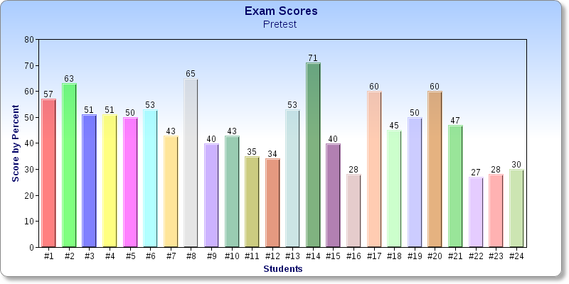

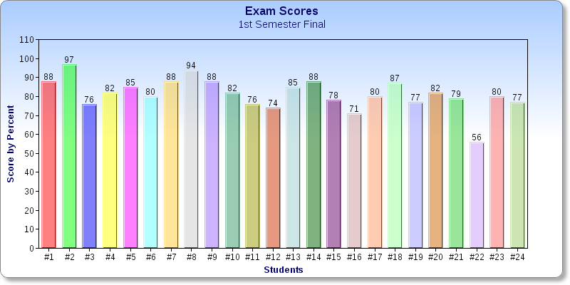

Slide 18
Example
I will create benchmarks and standards for Area Studies Wisconsin to help it come into compliance with district initiatives and institute benchmark grading and feedback for my second semester classes and compare them to my Area Studies Wisconsin classes from the first semester to show progress as evidenced by at least a 3% decrease in failures from first to second semester after the implementation of the benchmarks.

